Slide 1
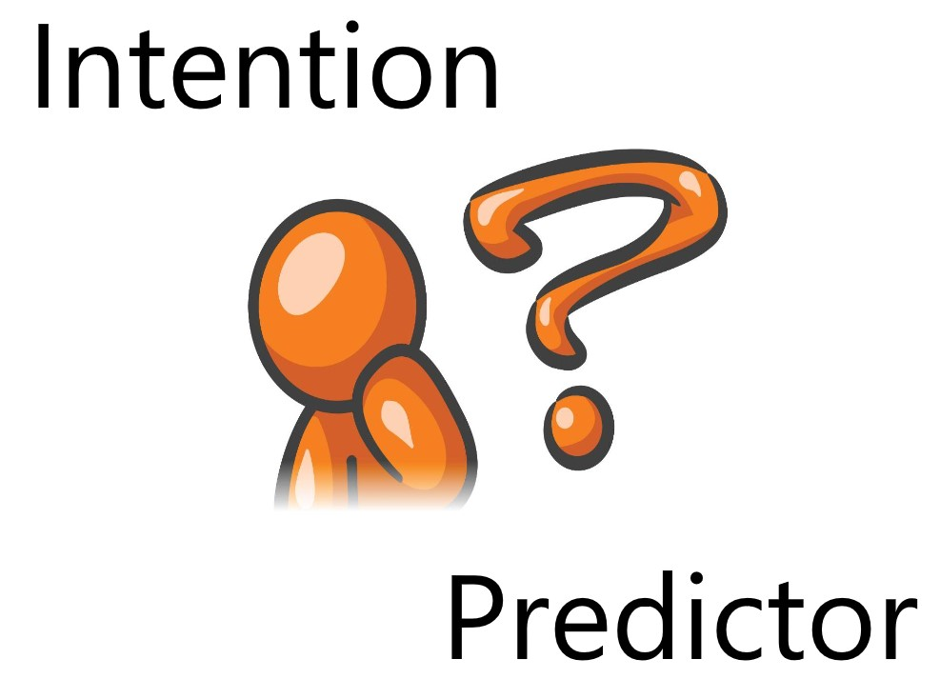
CONSUMER INTENTION PREDICTION USING TWITTER (CIP)

Slide 2
Supervisor
Miss Nida Saddaf Khan
Group Members
M. Saad Salman
M. Ammar Saleem
Hasan Imran

Slide 3

Overview of the presentation
Introduction
Research work
Project Overview
Process Flow Diagram
System level overview
Results
Learning outcomes
Market evaluation

Slide 4

Introduction
Our project is a web application that predicts the likelihood/certainty that a customer will buy a product that he is interested in based on his social media posts such as Twitter tweets and user profile data.
This will help the company/business target a particular customer more efficiently and boost their sales.

Slide 5

Research Work
Identifying Purchase Intentions by Extracting Information from Tweets
RADBOUD UNIVERSITY NIJMEGEN, 2017
Tweetalyst: Using Twitter Data to Analyze Consumer Decision Process
The Berkeley Institute of Design, 2017
The Impact of Social Network Marketing on Consumer Purchase Intention in Pakistan
Asian Journal of Business and Accounting 10(1), 2017
Using Twitter Data to Infer Personal Values of Japanese Consumers
29th Pacific Asia Conference on Language, Information and Computation, 2015

Slide 6


Project Overview
We aim to analyze the tweets related to a product and identify the purchase intention in it. In this way we can rank the tweets which have high purchase intention and report the name of the person who tweeted as potential customer of product.
We will make a model by gathering tweets from users who have already expressed intention to buy the product and see their tweet history and if possible, their web search history as well. Using this model, we will input potential customers who have tweeted about the product but have not bought it yet! And based on the training data the model will estimate a prediction/likelihood of whether the customer will buy it or not.

Slide 7


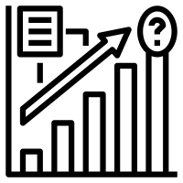

The Process Model
Step 1 Data acquisition and preprocessing
Crawl tweets that are related to the target product
Step 2 The Model
Train various text analytics models on the tweets and profile of users.
Clean, pre-process and transform the tweets
Choose the best model having highest performance measure.
Step 3 Predicting the Consumer Intention
Predict which consumers have shown the intention to buy the desired product.
Rank the customers according to their level/intensity of their purchase intention.
Step 4 Application
Companies and businesses can directly target those customers which have shown high intention to buy the product

Slide 8
Data acquisition and preprocessing
Used scraper to gather tweets
Used the following preprocessing techniques:
1. LOWERCASE
2. REMOVE PUNC
3. STOPWORDS REMOVAL
4. COMMON WORD REMOVAL
5. RARE WORDS REMOVAL
6. SPELLING CORRECTION
7. STEMMING
8. LEMMATIZATION
Next, we made 3 types of document vectors:
1. TF
2. IDF
3. TF-IDF

Slide 9
Modeling
We used the following text analytical models:
Support Vector Machine (SVM)
Naive Bayes
Logistic Regression
Decision Tree
Neural Network

Slide 10
Predicting the Consumer Intention
Using the models we predict which consumers have shown the intention to buy the desired product.
Rank the customers according to their level/intensity of their purchase intention.

Slide 11
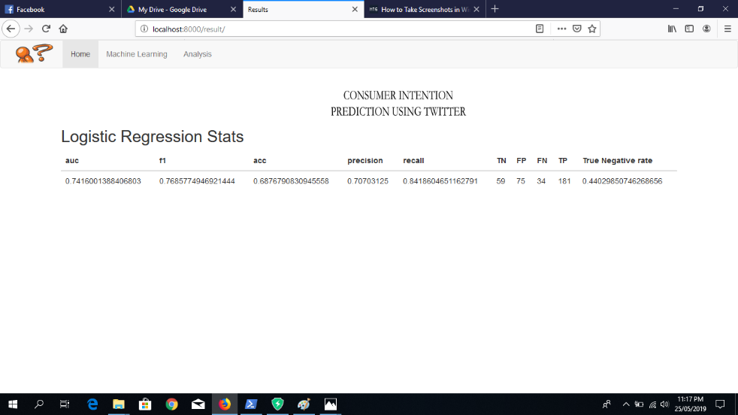
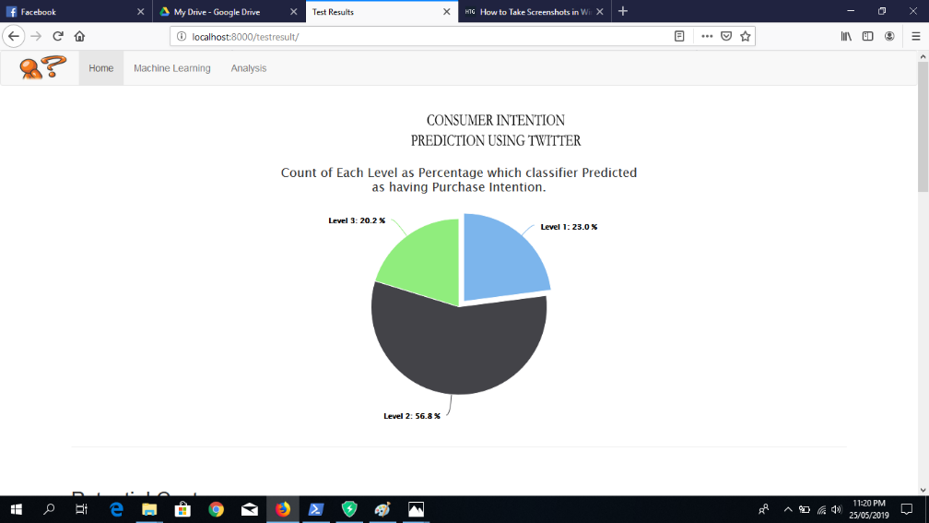
Application
We have developed a web application so that users can easily use our model and find purchase intention for their desired product.

Slide 12


System Level Overview of our Web Application
Firstly, the user will open the DASHBOARD and see the status of the product through charts and the relevant tweets for the product in a list.
Secondly, the user will press the UPLOAD ANNOTATED DATASET button through which he will be asked to upload the dataset he wants to test for his product and find the relevant customers from that dataset. The output will be in a form of a pie chart and a table showing the different level of customers and the scores assigned to each customer.
Thirdly, when the user presses the ANALYSIS button, he will be taken to the screen which will show the detailed analysis of our dataset that we have built containing word clouds, positive vs negative tweets and the most used words for that product.

Slide 13
Results
We have tested the model accuracy by confusion matrix:
Accuracy
Precision
Recall
F-Measure
Further we have also considered:
the True Negative Rate
the True Positive Rate
the shape of the ROC curve for each model.

Slide 14
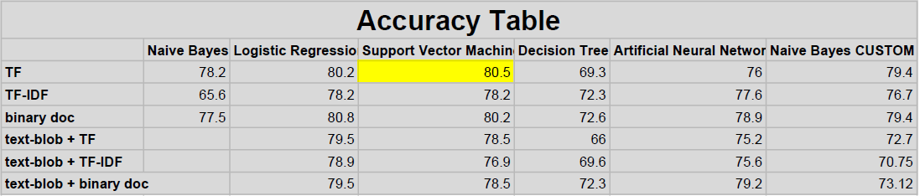
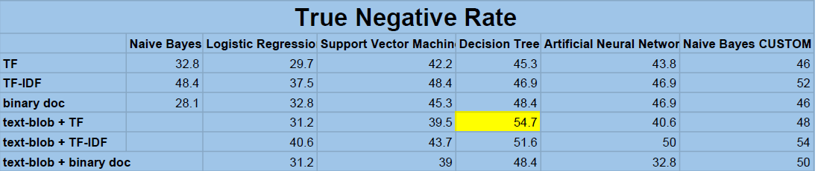
Results

Slide 15
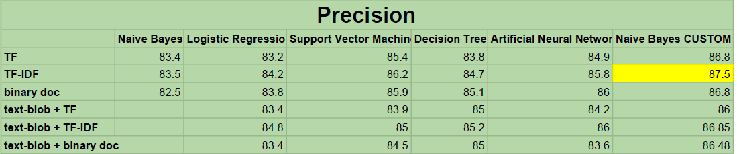
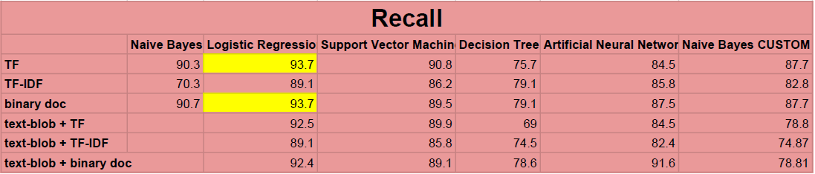
Results

Slide 16
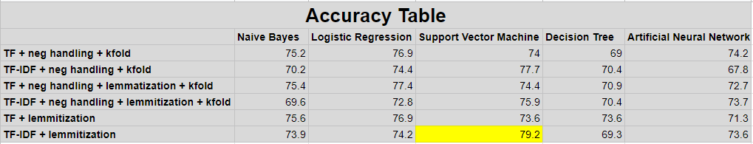
Results
For our second attempt after reorganizing the data preprocessing steps and adding some customized steps specific to our data, we got these results:

Slide 17

Learning Outcomes
Our results were quite promising since we had created our own dataset and were building the model from scratch. We had to create our own dataset because there does not exist a publicly available dataset for purchase intention based on twitter tweets.
The 2 major problems that we faced were:
1. The imbalance class problem: Since our dataset was manually annotated by us, we had about 2000 positive tweets and 1200 negative tweets. Due to this we were getting a very low True Negative Rate and our model was not accurately predicting the negative class.
2. Limited annotated data: Since we had to manual annotate each tweet in the dataset and this process takes a lot of time, we were only able to annotate about 3200 tweets.
Looking at the other researches that are done in the similar field, our project also stands apart since we have implemented 5 different models and after evaluating them, we choose the best one customized to the product data.
We were not able to get more than 80% accuracy because of the two problems highlighted above. To achieve even 80% accuracy with an imbalance class data and such a small dataset is a victory.

Slide 18
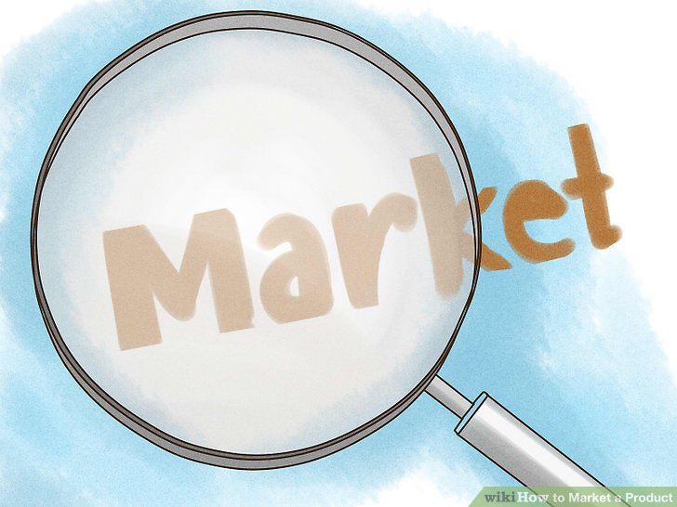
Market for Product
After showing the website to a few potential clients we have received positive remarks about our product and people seem interest in this new approach to customer identification and targeted marketing.

Slide 19

Thank you!

Slide 20
Questions?

